Slide 1


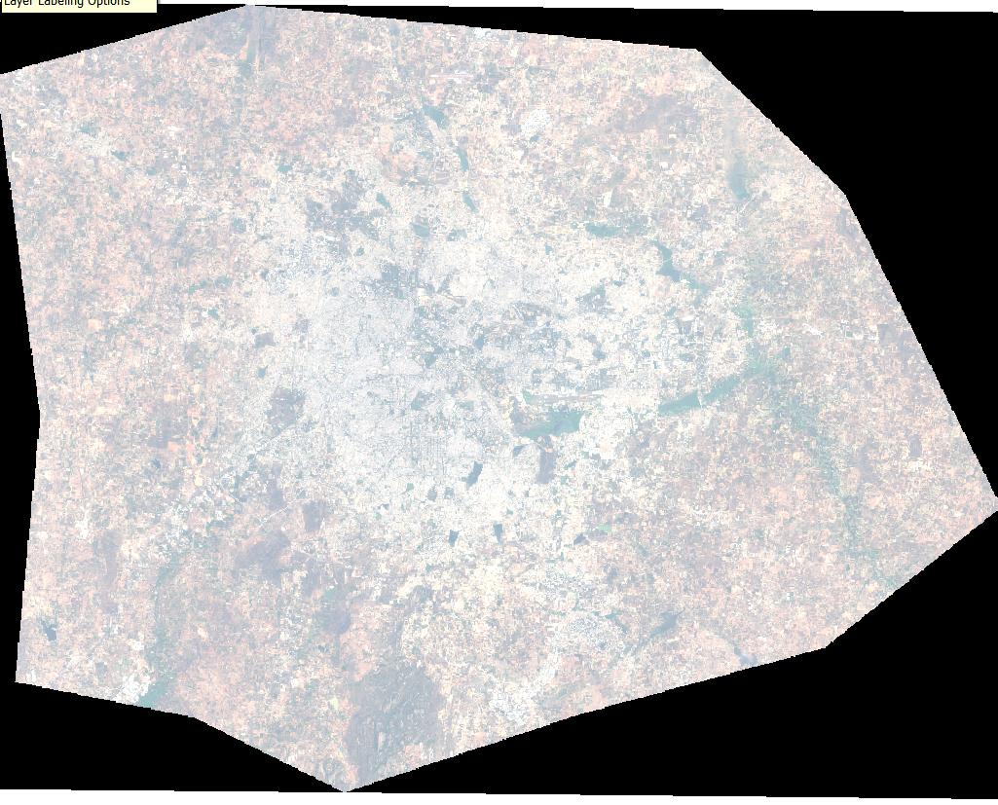
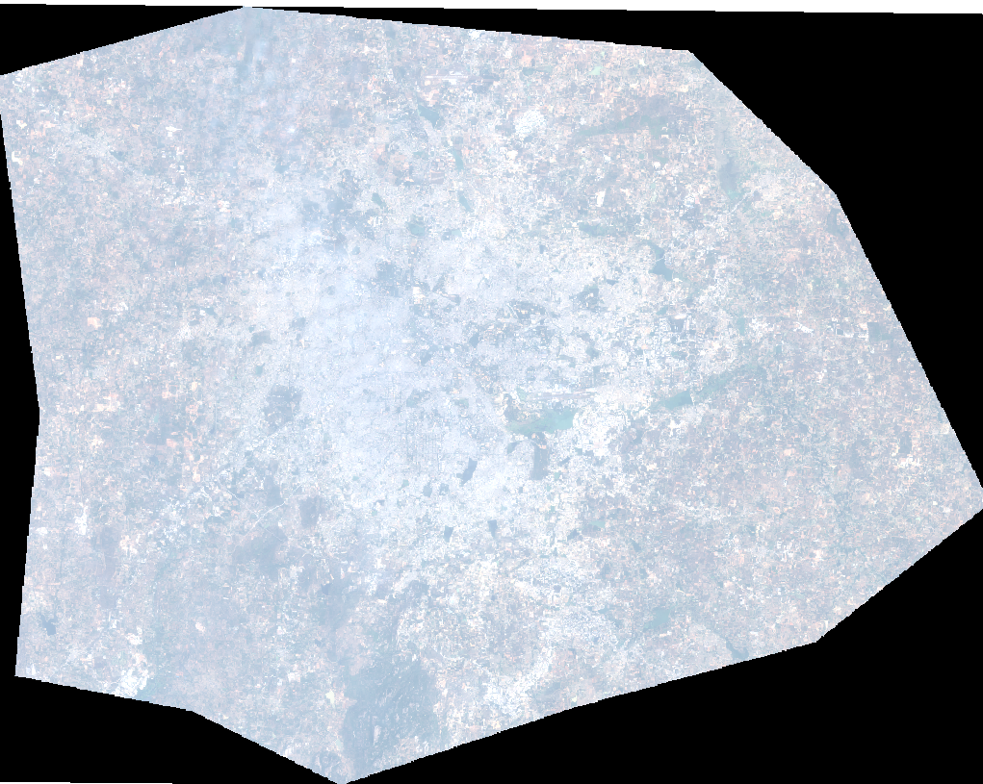
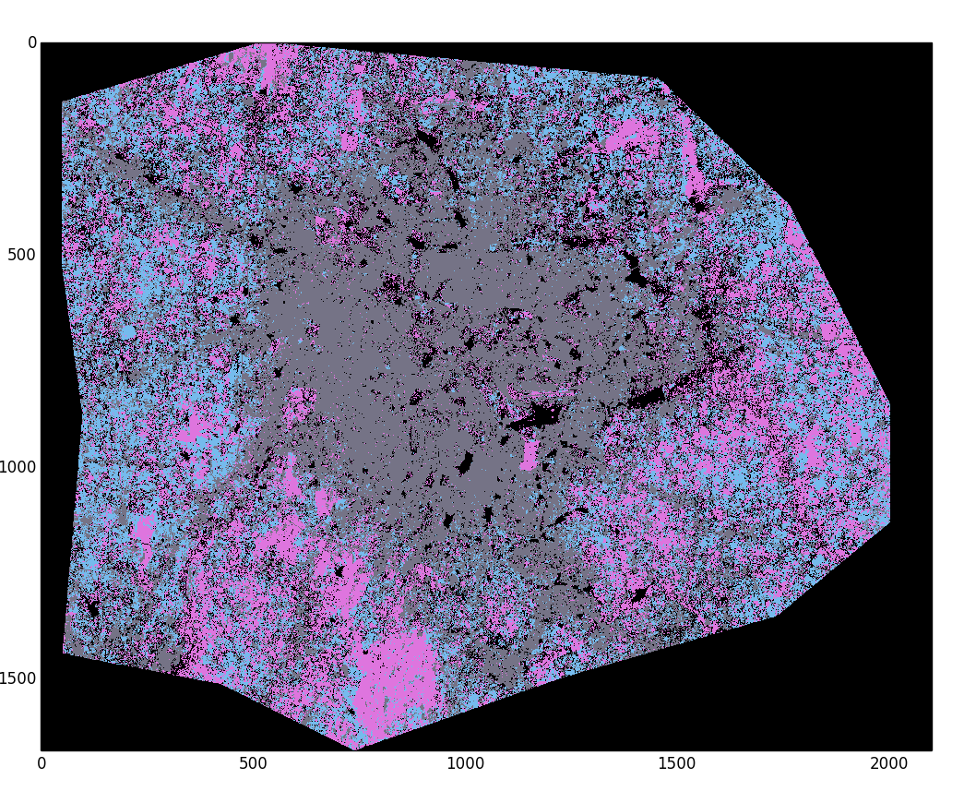
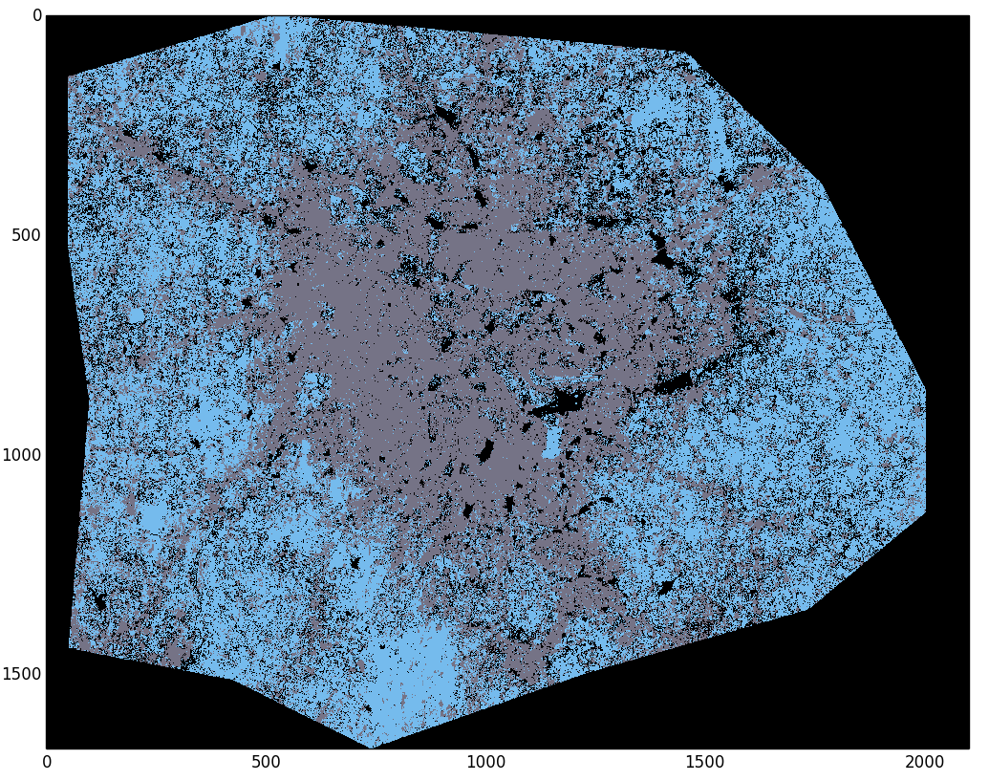
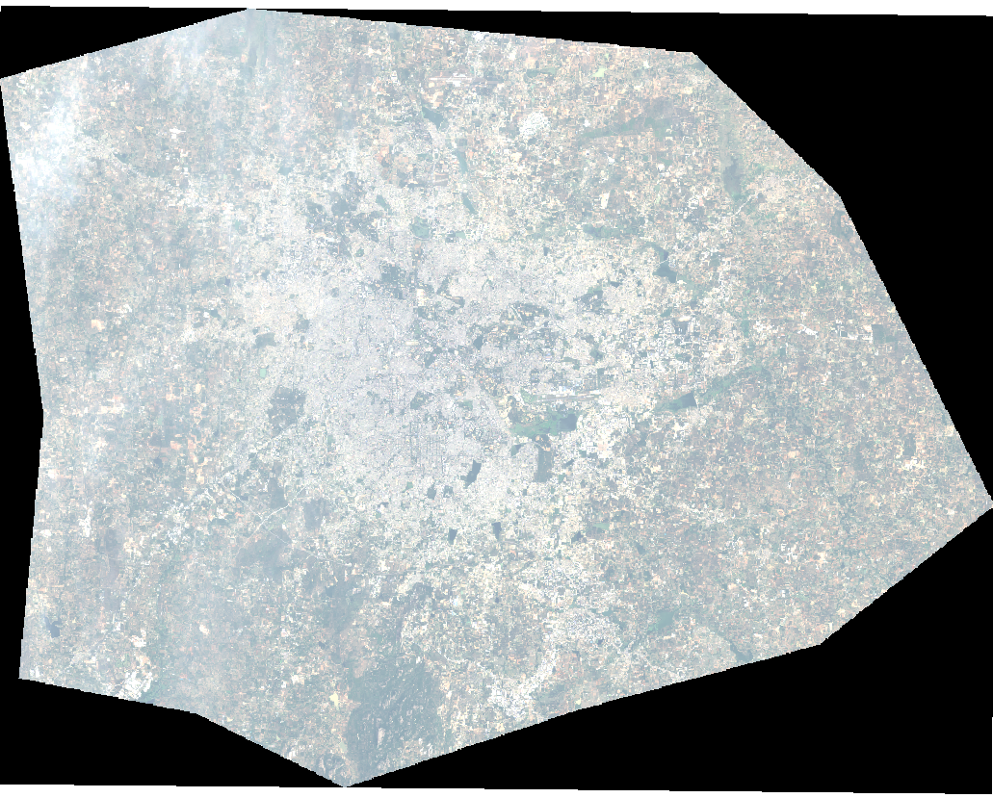
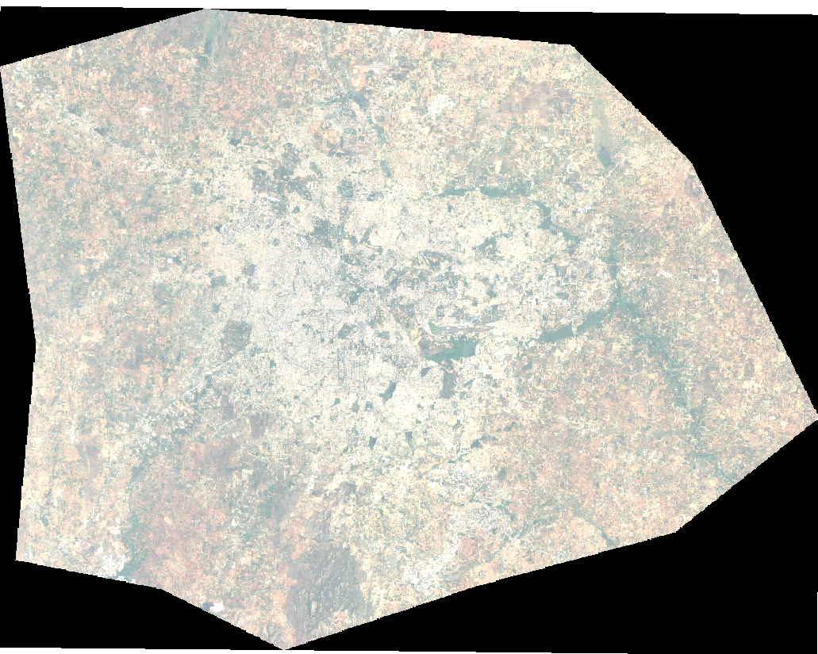
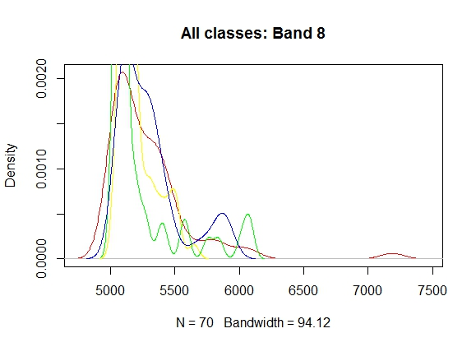
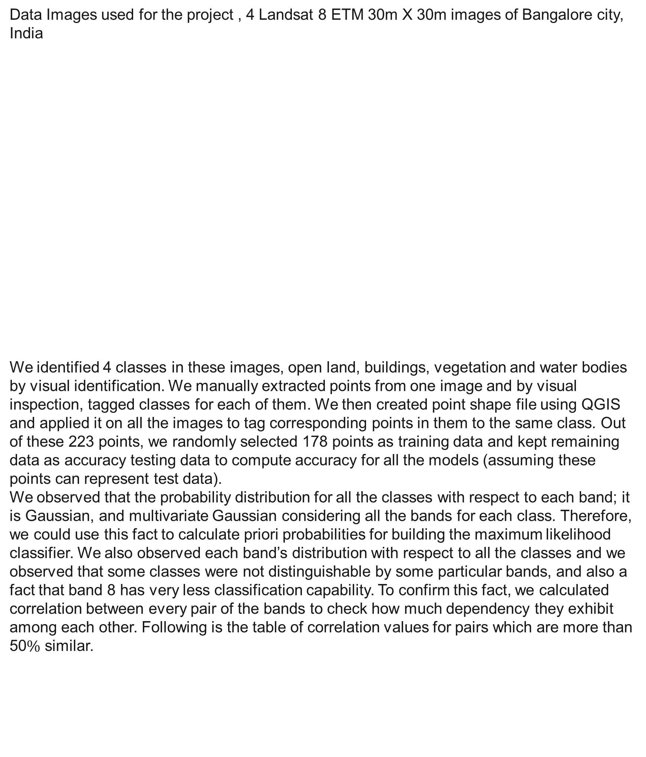
Multi Temporal Classification Of Satellite Images
Ankur Garg, Dhananjay Sathe, Kushal Nawalakha, Pranav Nawathe, Sanket Shahane
Department of Computer Science
Introduction
<Technical section>
Parameter choices
Studying spatial changes using multi temporal remotely sensed images has been an active field of research. This type of information has varied uses from monitoring the agricultural land use, natural resource management such as water resource monitoring to study the changes in metropolitan areas in temporal sense. These type of studies, which are generally known as Land Use and Land Cover (LULC) are of great interest to governments to make strategic decisions about the land use. Landsat classification can be used to produce accurate landscape change analysis and statistics. In this study, our focus is on analysing LULC changes in urban settings, particularly in Bangalore city, India.
MLC works well if the data in the image is spectrally well separable. But, most of the times, due to changes in reflectance of earth’s surface during various seasons and other factors like moisture content, terrain, the data becomes not well separable and poses many classification errors. Hence, it becomes necessary to study analyse data from various seasons to improve the classification results. Using multitemporal data, this error can be reduced as it enables us to consider changing spectral signatures of same class over different images.
We are using MLC as our initial classification algorithm. MLC uses prior information about the expected distribution of classes in final classification stage. This prior information is used through use of priori probabilities – probabilities of occurrence of classes, that is weighing the classes as per their expected distribution in output dataset. Now, MLC will classify the given image and as we are using multiple images, each classification criteria for corresponding image will be different from the rest, this criterion we call as model corresponding to that image. But at the end, we need a single decision for each test point, and for this purpose we are using Bayesian Model Averaging (BMA) to combine all the decisions from the models.
One problem with kNNs was suspected to be the need for a good distance function.
CNNs make the assumption that inputs are images.
K-L divergence is a measure of distance between distributions.
<Diagram for best performing model>
Input image -> Gaussian mixture model -> kNN to GMM templates using K-L divergence.
Number of components in Gaussian Mixture Models = ...
Patch size = ….
Initial centers for the GMM were chosen as the centers from agglomerative hierarchical clustering because….
Components in pairs of GMMs were matched using …
OR
Batch size, learning rate, learning rate decay, momentum, network architecture, activation function. Reasons for all choices.
(Note: Use bullet points, no paragraphs)
Data description
Results
Data Images used for the project , 4 Landsat 8 ETM 30m X 30m images of Bangalore city, India
We identified 4 classes in these images, open land, buildings, vegetation and water bodies by visual identification. We manually extracted points from one image and by visual inspection, tagged classes for each of them. We then created point shape file using QGIS and applied it on all the images to tag corresponding points in them to the same class. Out of these 223 points, we randomly selected 178 points as training data and kept remaining data as accuracy testing data to compute accuracy for all the models (assuming these points can represent test data).
We observed that the probability distribution for all the classes with respect to each band; it is Gaussian, and multivariate Gaussian considering all the bands for each class. Therefore, we could use this fact to calculate priori probabilities for building the maximum likelihood classifier. We also observed each band’s distribution with respect to all the classes and we observed that some classes were not distinguishable by some particular bands, and also a fact that band 8 has very less classification capability. To confirm this fact, we calculated correlation between every pair of the bands to check how much dependency they exhibit among each other. Following is the table of correlation values for pairs which are more than 50$\%$ similar.
Conclusions
<what conclusions did you draw from your semester long work>
CNNs perform the best on this task because….
Random forests beat all other methods by a huge margin because….
<diagrams showing the results of your method>
(For example,
For CNNs for classification, true positive, one false positive, one false negative. Learning curves for loss vs. number of iterations, training and testing accuracies vs. number of iterations.
For GMMs, a portion of the image (original and classified) that the method found hard to discriminate.
Table with performance of different methods under some accuracy measure.
Performance (qualitative or quantitative) of your methods under different parameter settings.)
References
Bands | Correlation
Ultra-Blue and Blue | 0.99
Green and Blue | 0.8
Red and Green | 0.9
Red and SWN1R1 | 0.76
Green and SWN1R2 | 0.65
Red ad SWN1R2 | 0.79
SWN1R1 and SWN1R2 | 0.96
GitHub link https://github.ncsu.edu/svshahan/Multi-Temporal-Classification
Raju’s paper
http://www.isprs.org/proceedings/XXXV/congress/comm4/papers/480.pdf
http://www.sciencedirect.com.prox.lib.ncsu.edu/science/article/pii/0034425780900115
http://www.qgis.org/en/site/
http://www.sciencedirect.com.prox.lib.ncsu.edu/science/article/pii/S0034425705002646
https://link.springer.com/book/10.1007/978-3-642-30062-2
http://ieeexplore.ieee.org.prox.lib.ncsu.edu/document/905255/
https://link.springer.com/chapter/10.1007%2F978-3-642-19721-5_1

